Slide 1
MTU PowerPoint Title
Subtitle
Presenter Name
01 January 2021

Slide 2
Basic slide template
Keep it simple….
Don’t use too many lines or words. State your point!
Avoid big chunks of text.
Use styles and themes provided in this template.
Avoid using more than two levels of bullets.

Slide 3
Bar chart sample layout
Right click to edit chart data in Microsoft Excel

Slide 4
Pie chart sample layout
Right click to edit chart data in Microsoft Excel

Slide 5
Line chart sample layout
Right click to edit chart data in Microsoft Excel

Slide 6
Table sample layout
Department | 2022 | 2021 | 2020
Row 1 | 100% | 100% | 100%
Row 2 | 100% | 100% | 100%
Row 3 | 100% | 100% | 100%
Row 4 | 100% | 100% | 100%
Row 5 | 100% | 100% | 100%
Row 6 | 100% | 100% | 100%
Total | 100% | 100% | 100%

Slide 7

Sample Photo Layout
You can replace the image by right clicking the photo and selecting change picture or by selecting a new photo slide template layout in the menu.

Slide 8

Sample Photo Layout
You can replace the image by right clicking the photo and selecting change picture or by selecting a new photo slide template layout in the menu.

Slide 9
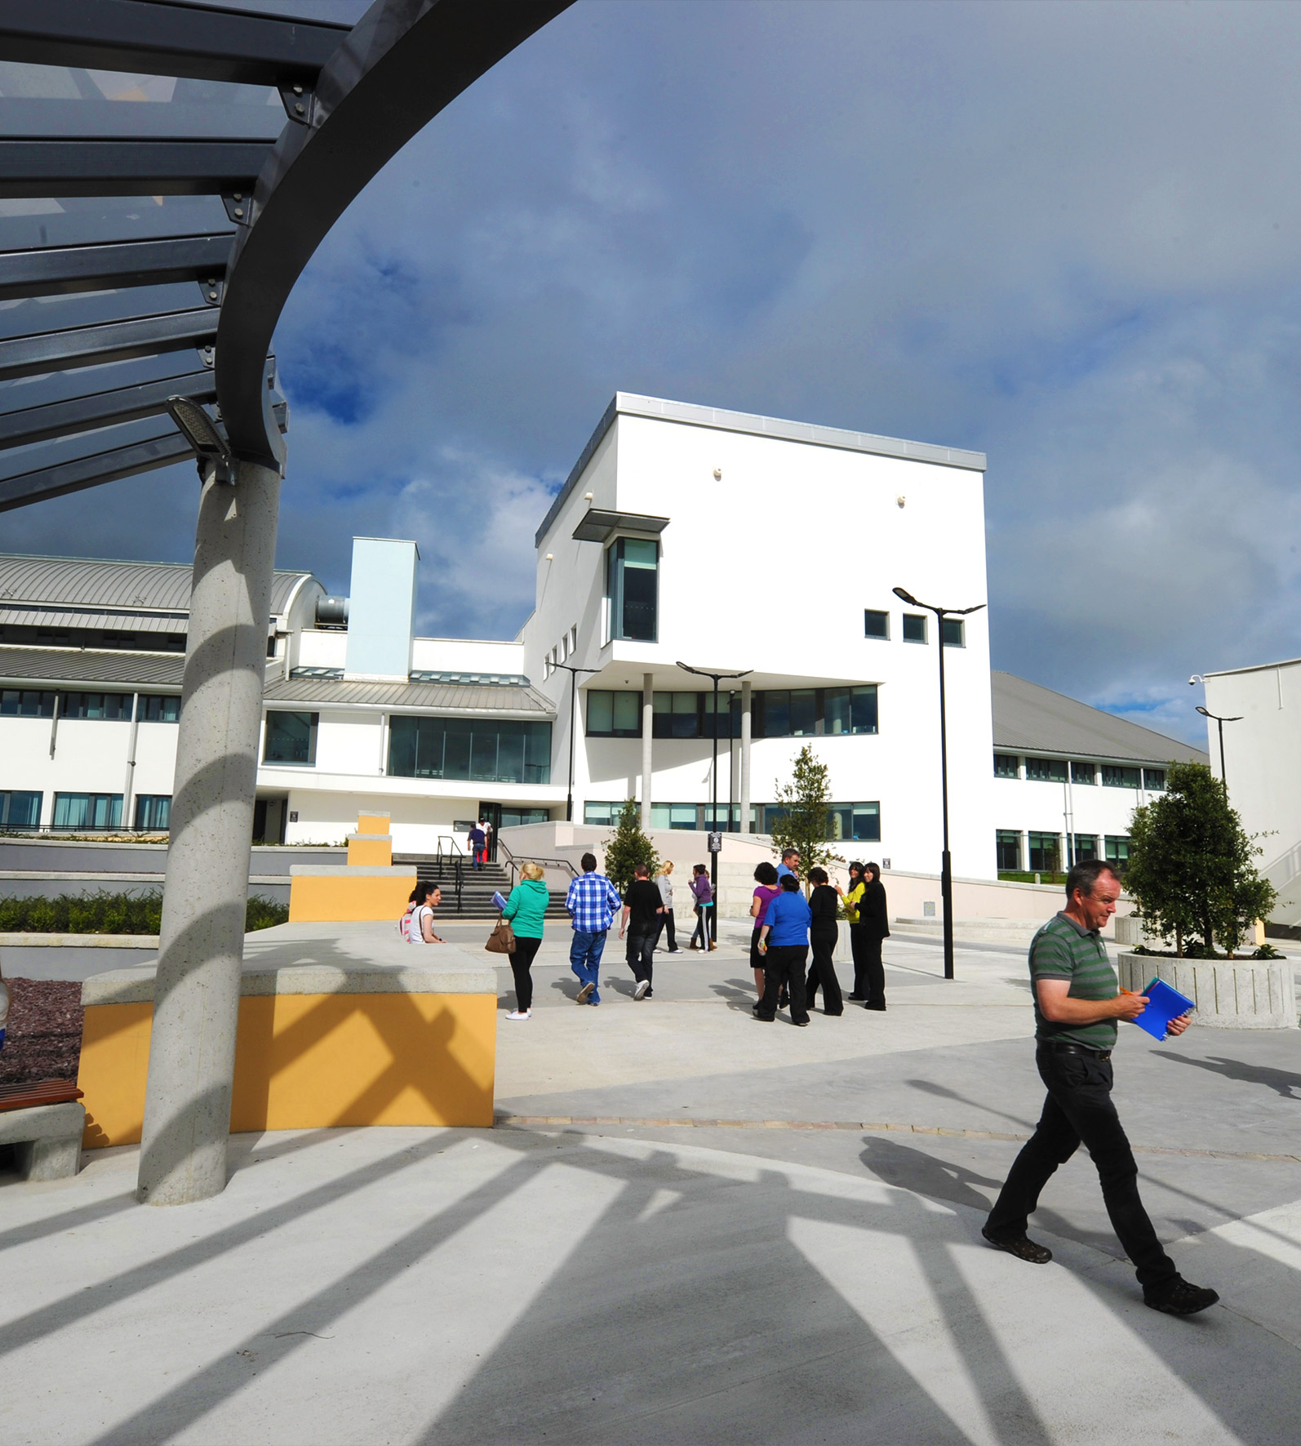
Sample Photo Layout
You can replace the image by right clicking the photo and selecting change picture or by selecting a new photo slide template layout in the menu.

Slide 10

Sample Photo Layout
You can replace the image by right clicking the photo and selecting change picture or by selecting a new photo slide template layout in the menu.

Slide 11

Sample Photo Layout
You can replace the image by right clicking the photo and selecting change picture or by selecting a new photo slide template layout in the menu.

Slide 12

Sample Photo Layout
You can replace the image by right clicking the photo and selecting change picture or by selecting a new photo slide template layout in the menu.

Slide 13

Sample Photo Layout
You can replace the image by right clicking the photo and selecting change picture or by selecting a new photo slide template layout in the menu.

Slide 14
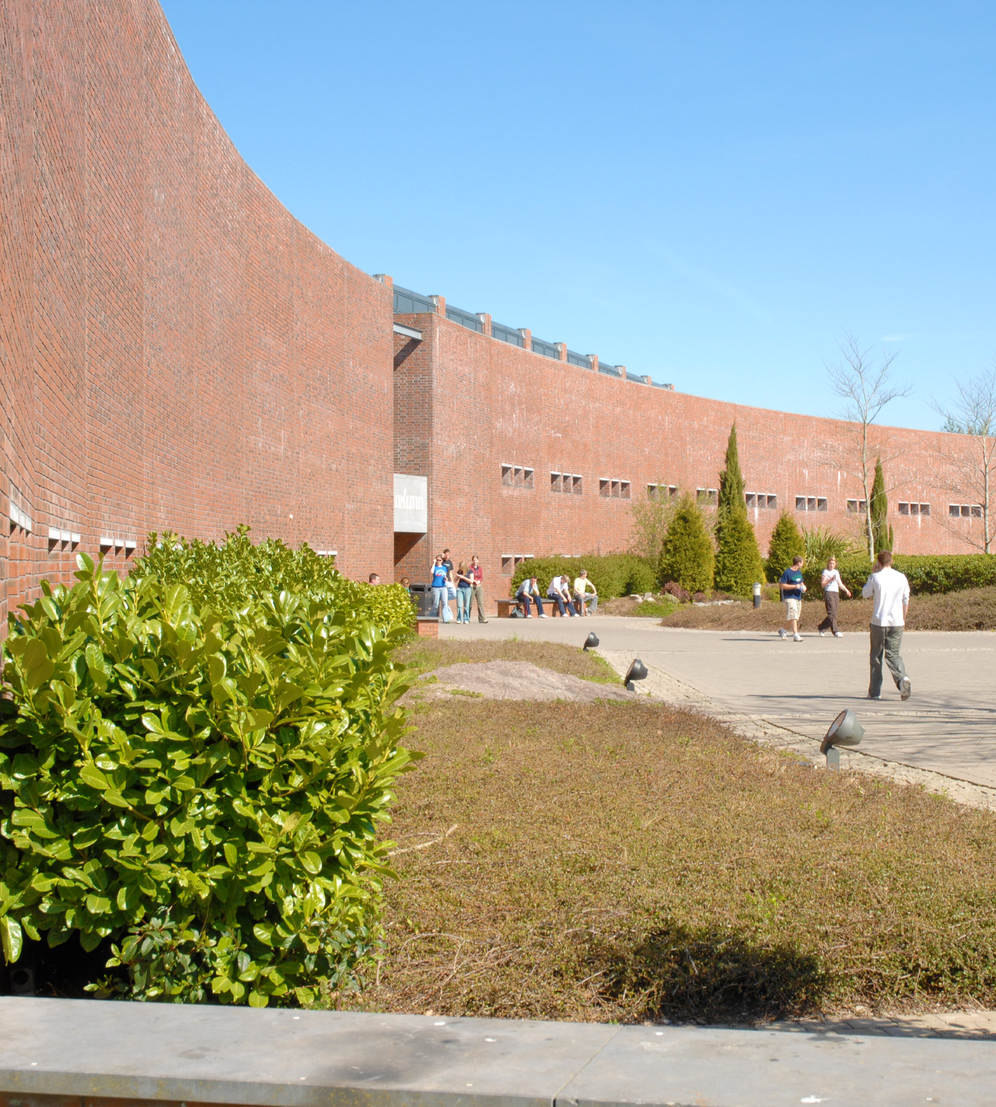
Sample Photo Layout
You can replace the image by right clicking the photo and selecting change picture or by selecting a new photo slide template layout in the menu.

Slide 15

Sample Photo Layout
You can replace the image by right clicking the photo and selecting change picture or by selecting a new photo slide template layout in the menu.

Slide 16
Thank You!
For more information, please email hello@mtu.ie
Presenter Name
01 January 2021

